Slide 1


DEPARTMENT OF ARTIFICIAL INTELLIGENCE AND DATA SCIENCE
Presentation
For
Mid-Term : 2
Machine Learning Lab Project (6CAI4-22)
Skin Cancer Classification
Session-2022-23(Even)
Presented by
Student Name: Harsh Nama(TL),
Yash Nagla & Lakshay Bhatiya
Section: G
Presented to :
Faculty : Mohnish Sachdeva

Slide 2
Skin cancer classification
Introduction :-
Given the rising prevalence of skin cancer and the significance for early detection, it is crucial to develop an effective method to automatically classify skin cancer.
Although traditional machine learning approaches are capable of performing well in particular skin cancer classification tasks, these algorithms are ineffective for complicated diagnostic demands in clinical practice. Traditional machine learning methods for skin cancer diagnosis typically involve extracting features from skin-disease images and then classifying the extracted features.

Slide 3
Objective of Project
Understanding of the classification system.
Improve the Quality of the Skin Cancer Classification.
Improving Scalability.
Enhancing the user experience.

Slide 4
Scope of the Project
Objective: The project aims to enhance the accuracy, quality, and scalability of Skin Cancer Classification systems by employing a ‘Content Based’ approach that combines content-based filtering.
Content-based Classification System :
Content-based filtering is one popular technique of classification or classifier.
The content or attributes of the things you like are referred to as "content".
Here, the system uses your features and likes in order to recommend you
with things that
you might like. It uses the information provided by you over the internet and the ones
they are able to gather and then they curate recommendations according to that.
The goal behind content-based filtering is to classify products with specific keywords,
learn
what the customer likes, look up those terms in the database, and then recommend
similar things.
This type of classification system is hugely dependent on the inputs provided by users,
some common examples included Google, Wikipedia, etc. For example, when a user
searches for a group of keywords, then Google displays all the items consisting of those
keywords.

Slide 5
Requirement Analysis
Hardware Requirement for Development
Core i3 processor
2GB Ram.
20GB of hard disk space in terminal machines
100GB hard disk space in Server Machine
Software Requirement
Operating System : Windows 7 or Higher
Font-End Tool : Stream lit
Back-End : PyCharm, Jupyter Notebook
Python Libraries

Slide 6
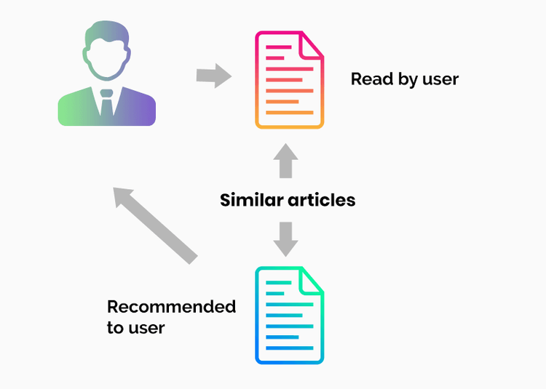
Content Based filtering :

Slide 7
Product Perspective
Accurate assessment of model performance
Identification of risks and errors
Diagnostic support for healthcare professionals
Tailored treatment planning based on model strengths and weaknesses
Continuous monitoring of model performance
User-friendly interface for easy interpretation
Decision support for clinical decisions and patient education
Customization and integration into existing healthcare systems
Alignment with regulatory compliance standards
Continuous improvement through analysis and user feedback.

Slide 8
Conclusion
Globally, there is a drastic increase in the rate of skin cancer cases because of several factors. So early detection plays a crucial role in detection and treatment. Thus, this paper discusses an approach based on the MSVM classification, where it uses two effective methods called ABCD and MSVM for feature extraction. The accuracy achieved is about 96.25%. The proposed system uses eight types of skin cancers for classification and to obtain high accuracy and precision.Table 1Extracted features and their values.

Slide 9
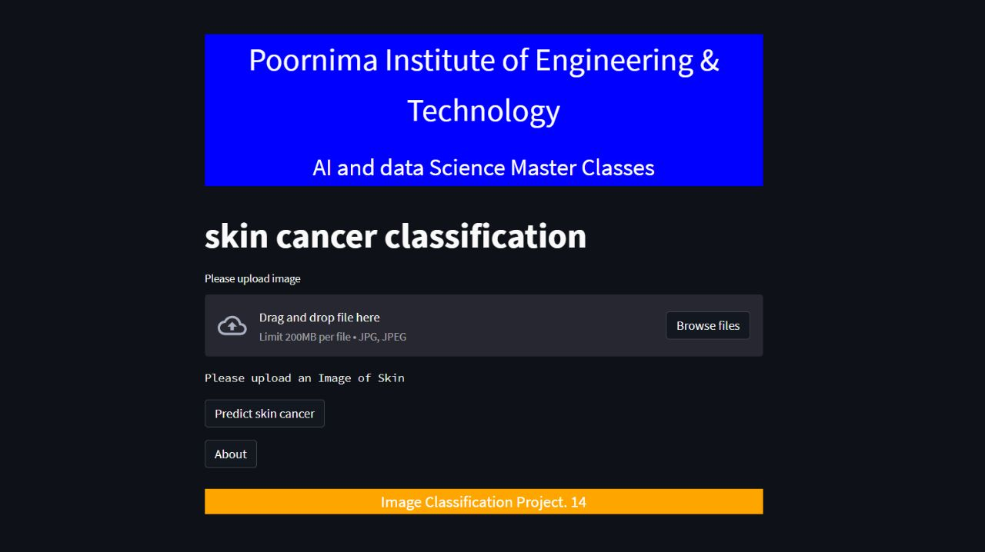
Screen shots

Slide 10
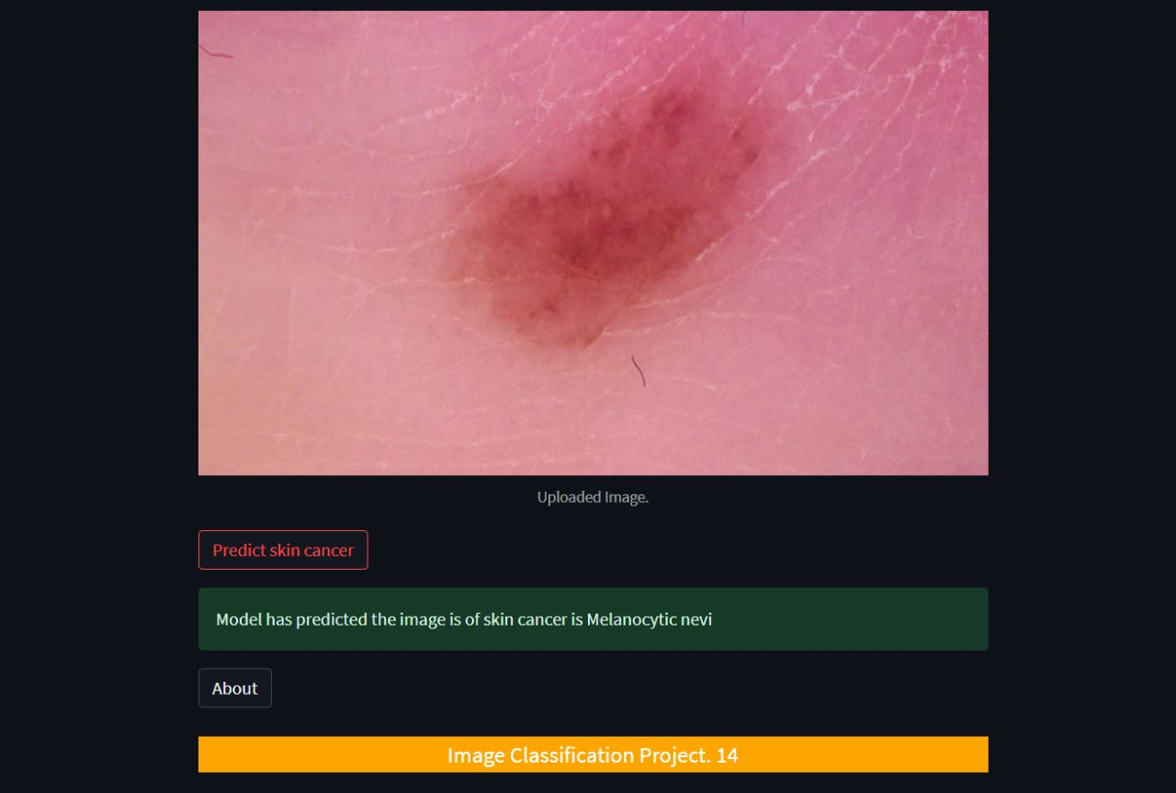
Screen shots

Slide 11
Thanks

